Slide 1


accidentsHappen
Robert Lau
Kim Ngo
Joshua Rivera
Simranjot Singh
University of California Berkeley Extension
Data Analytics and Visualization Bootcamp (May-Oct 2020)

Slide 2
Executive Summary
Our team became interested in this project topic because one of our members was involved in a severe car accident. Due to bad road conditions, their car skidded across the freeway, onto the center divider. As a result, our member was hospitalized. Their story inspired us to use a dataset to analyze and predict the chances of getting in an accident based on specific criteria and data. We see great potential in utilizing this dataset to provide interesting insights and research.
By entering certain criteria such as zip codes, seasonal trends, severity, and traffic attributes, one can better forecast the chances of getting into a car accident. It is a simple and easy tool that any driver can use.
A Kaggle dataset of car accidents in the contingent US from 2016-2020Programs utilized for this project:
Programs will be using during this program:
ETL: Python, Jupyter Notebook, PostgreSQL
Visualizations and Dashboard: JavaScript, CSS, HTML
Forecasting and Analysis: Supervised Machine Learning

Slide 3
Extract Transform Load (ETL)
Dataset Timeline is from February 2016 to June 2020. Uses traffic incident events API hosted on Kaggle*. Initial raw data is parsed from various US transportation departments, traffic cameras and sensors.
Jupyter Notebook with Python integration and Pandas library utilized to clean up dataset.
Various cleaning methods such as dropping NA values, splitting Start_Time column into various time attributes, creating segmented bins for categorical variables, filling NA values with 0 for necessary columns, etc.
PostgreSQL database was used to host our large CSV file locally, imported from Jupyter Notebook using sqlalchemy library.
Our cleaned dataset is 560 Megabytes and has 3.4 million rows with columns such as Latitude/Longitude, Zip Code, Temperature, Severity, etc.
Before cleaning, the dataset is of CSV format, with file size of 1.2 Gigabytes containing 3.5 million rows.

Slide 4
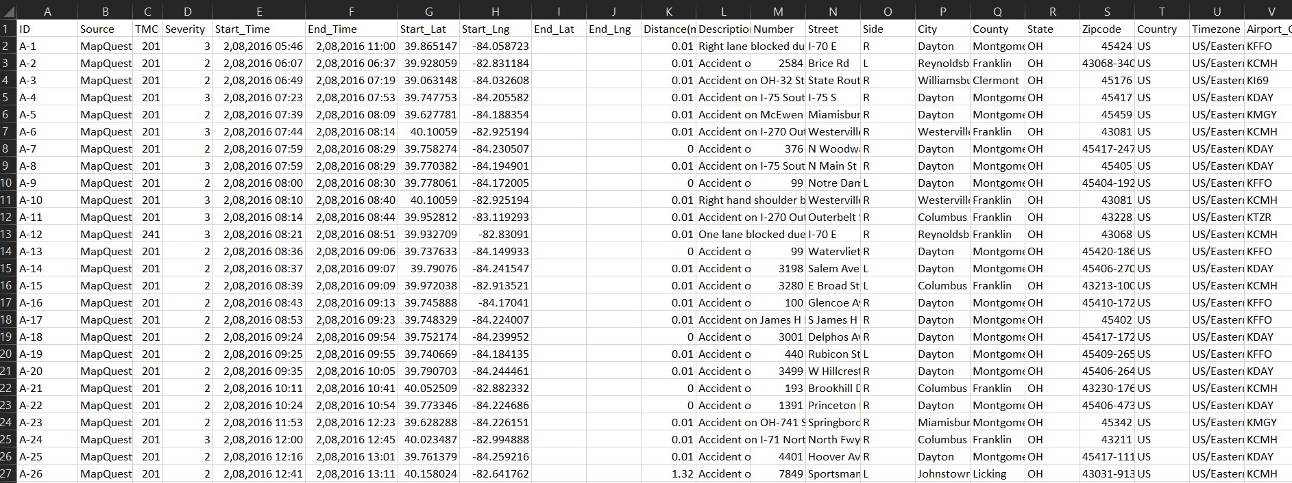
Raw CSV Dataset

Slide 5
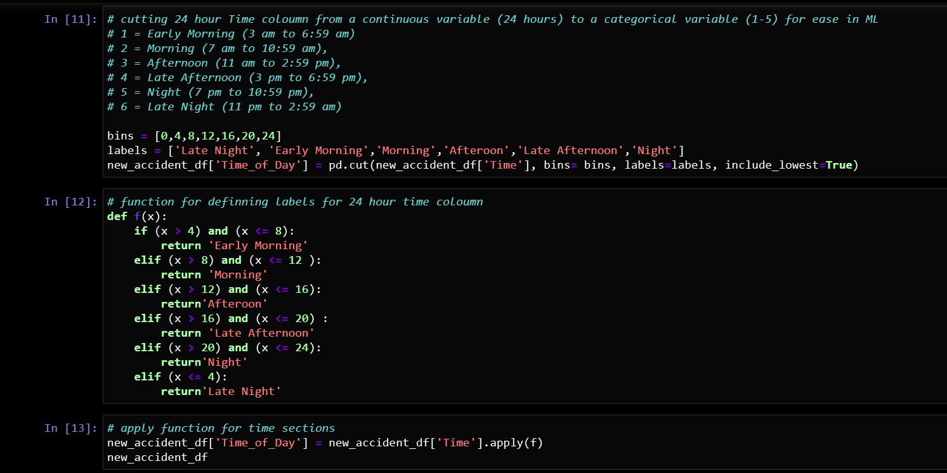
Jupyter Notebook

Slide 6
Database
PostgreSQL database…

Slide 7
Dashboard
Dashboard in progress…

Slide 8
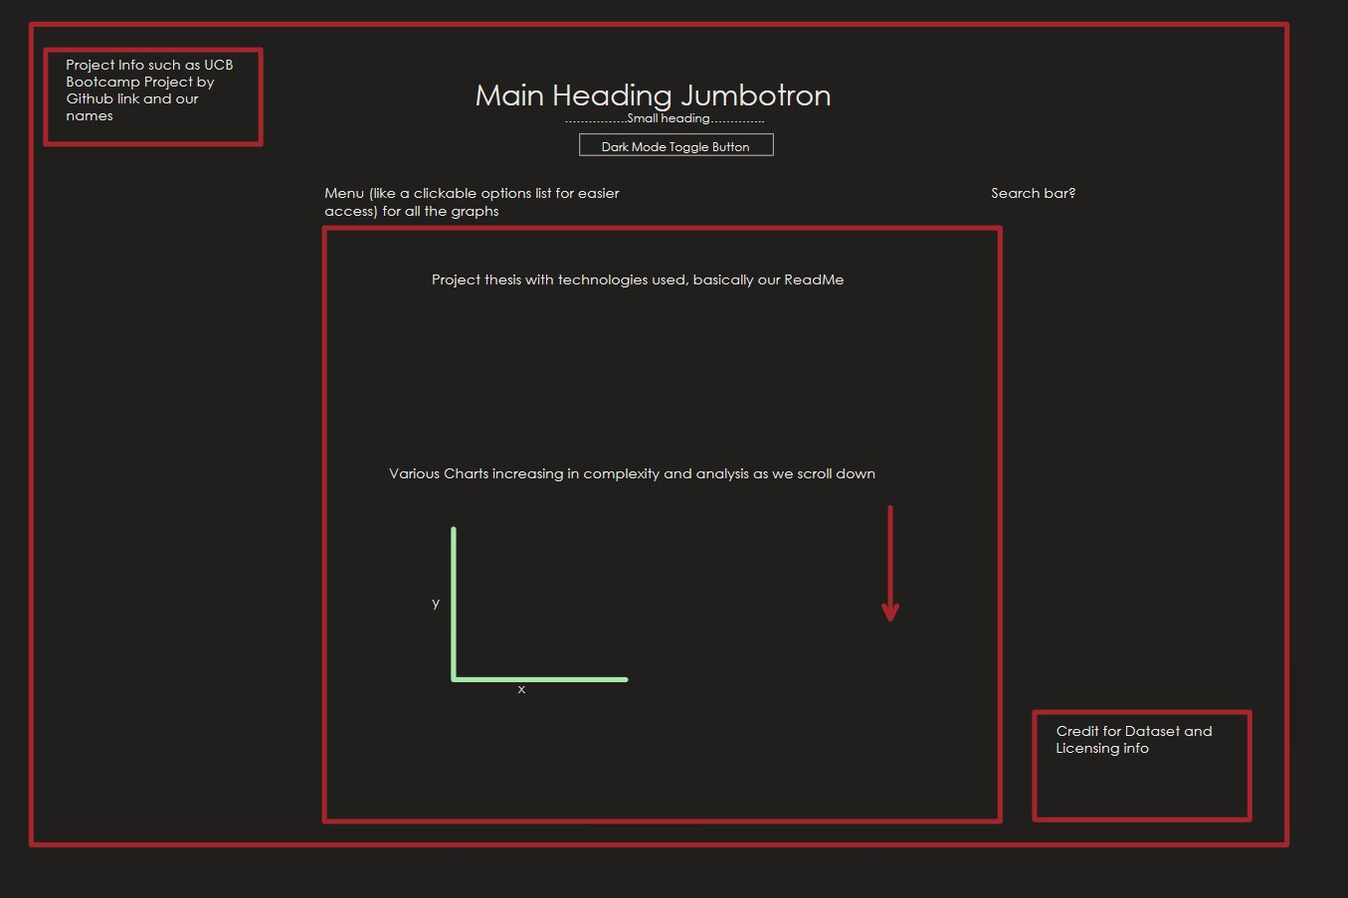
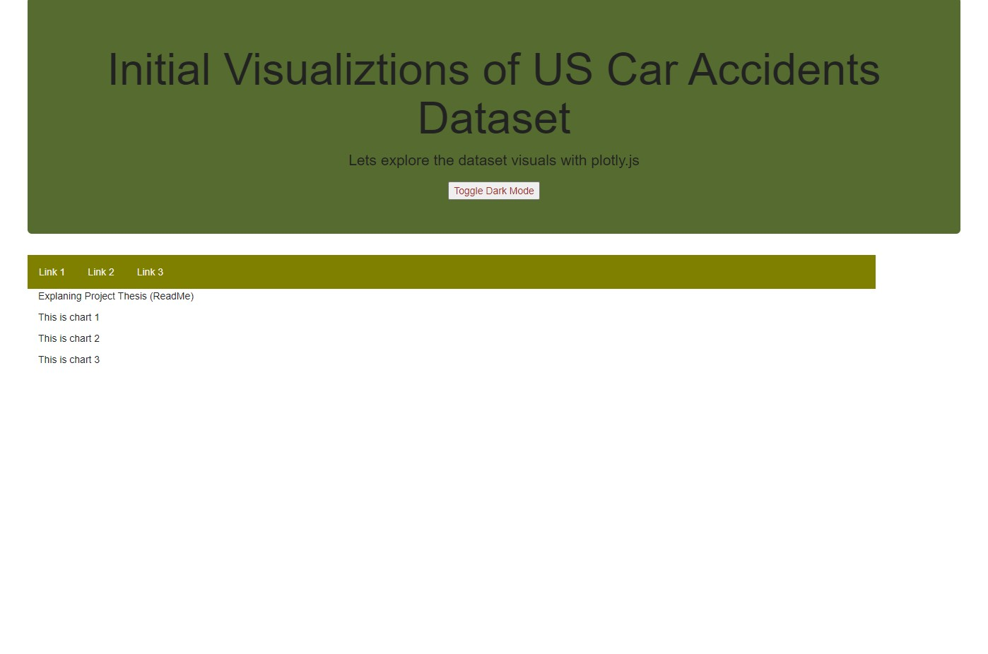
Dashboard Layout and Basic Design

Slide 9
Machine Learning
Soon….

